Slide 1

Smart Notice Board Display
Major Project - 1
CS- 805
Problem Statement: Traditional notice boards require manual updates, causing inefficiency, delays, and excessive paper usage. A smart, real-time, and eco-friendly solution is needed for instant announcements in educational institutions, offices, and public spaces.
Project Group Number: 25
Group Member Details:
Dharmeet Singh 0187CS211063
Devendra Upadhyay 0187CS211061
Devendra Mehra 0187CS211059
Dev Dabi 0187CS211057
Guide Details: Prof. Shweta Singh

Slide 2
Idea/Approach Details
Describe your idea Solution/Prototype here:
The core idea is to develop an “IoT-based Smart Notice Board Display” system that enables real-time updates of notices and announcements. The system uses a microcontroller connected to a wireless communication module (Wi-Fi/Bluetooth) to receive and display content on a digital screen. Administrators can remotely upload or modify messages via a web or mobile interface, ensuring instant updates and eliminating the need for manual intervention

Slide 3
Project Requirements
Functional Requirements
Non Functional Requirements
Wireless Message Update: The system should allow users to send messages remotely via Wi-Fi to the notice board.
Display Messages: The LED MAX7219 should properly display the messages received from the ESP8266.
Real-time Updates: Messages should be updated on the LED display in real-time when sent from a remote device.
Mobile/PC Compatibility: Users should be able to update messages using a web interface, mobile app, or cloud platform.
Power Management: The system should efficiently manage power, ensuring low energy consumption.
Reliability: The system should work continuously without failure.
Performance: The messages should appear on the LED display within a few milliseconds after being sent, ensuring a smooth and responsive experience.
Scalability: The system should allow multiple LED MAX7219 modules to be added for larger displays.
User-Friendly Interface: The web or mobile application used for updating messages should be easy to use.
Maintainability: The system should be easy to update and modify if required.

Slide 4
Project Requirements
Hardware and Software requirements
HARDWARE REQUIREMENTS
Microcontroller (ESP8266)
Display Screen (LED MAX7219 Matrix)
Wireless Communication Module (Wi-Fi , Bluetooth)
Power Supply (9V Battery)
Jumper Wire
SOFTWARE REQUIREMENTS
Arduino IDE: For Programming the Microcontroller
IoT Platforms (Blynk , Firebase)
Web/Mobile App Development Tools (MIT App, Flask)

Slide 5
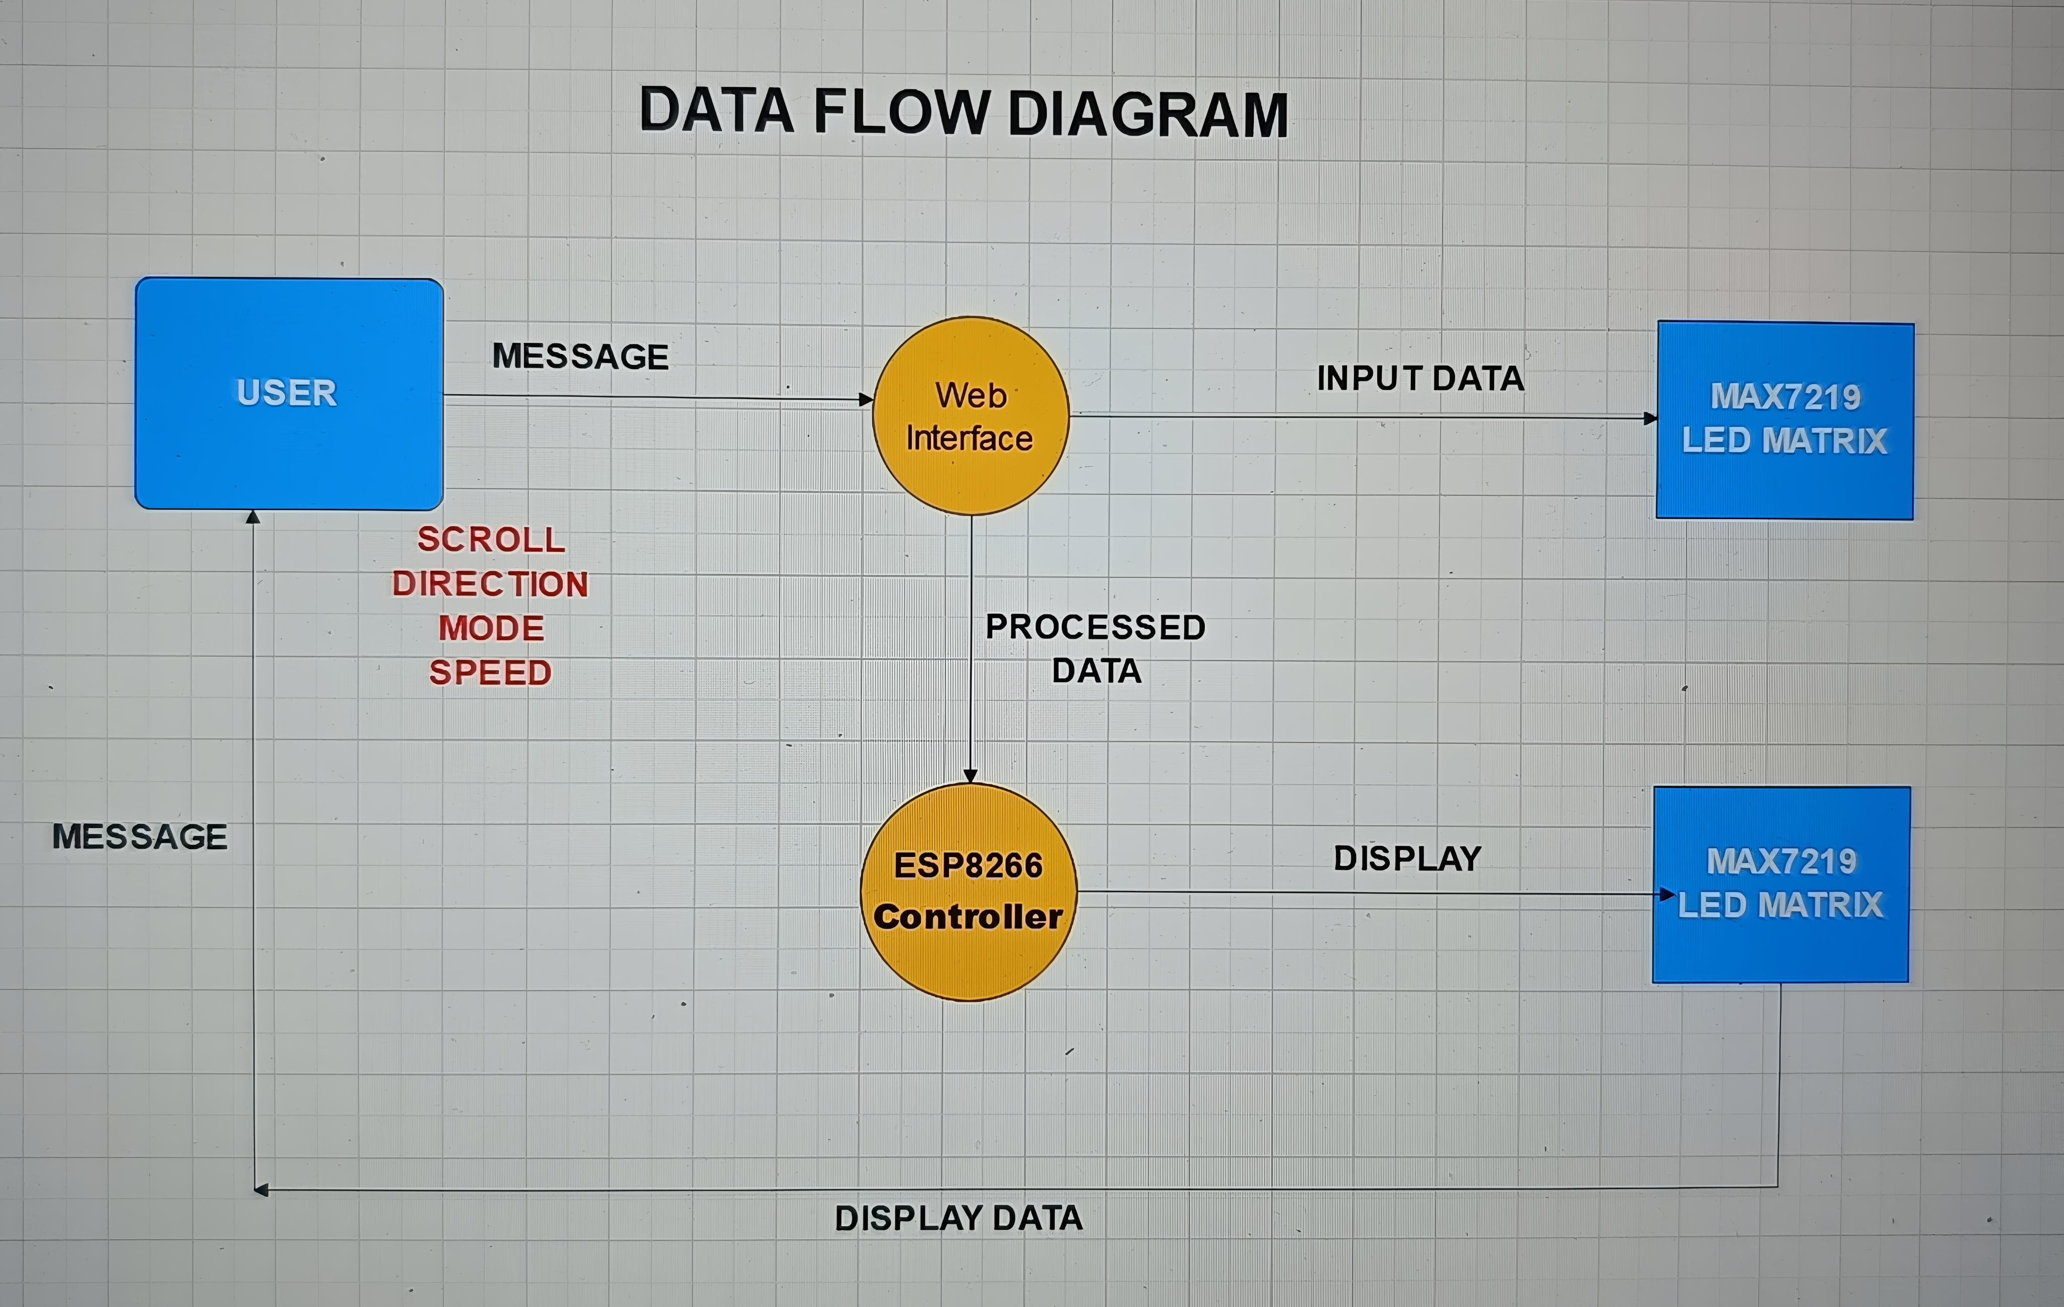
DFD Diagram

Slide 6
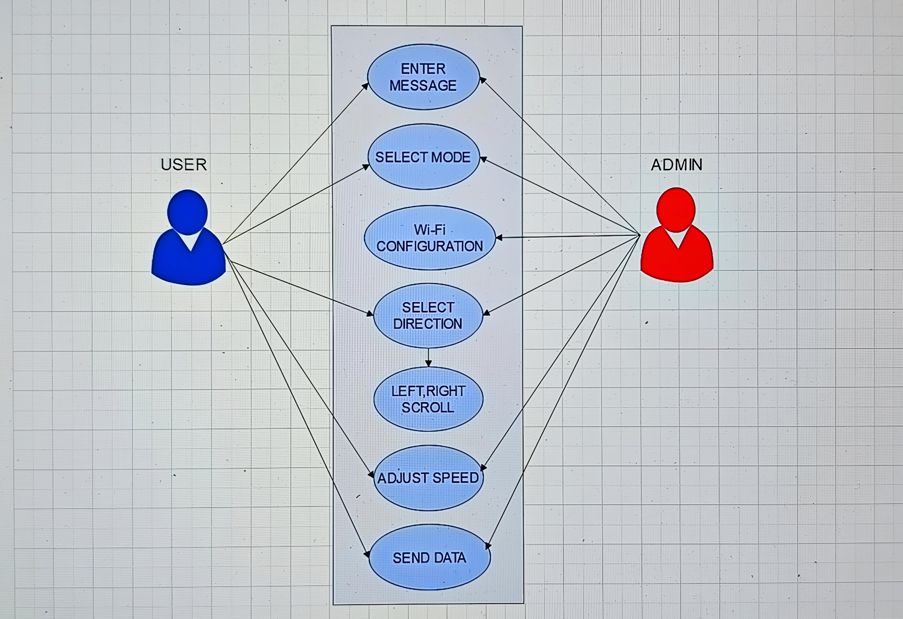
UseCase Diagram

Slide 7
Implementation Plan
Phase 1:
Setup the hardware components (microcontroller, display, and wireless module).
Develop the basic code for receiving and displaying messages.
Phase 2:
Integrate the system with a web/mobile interface for remote updates.
Test the system for real-time functionality.
Phase 3:
Deploy the system in a real-world environment (e.g., school, office).
Gather feedback and optimize the system for scalability.

Slide 8
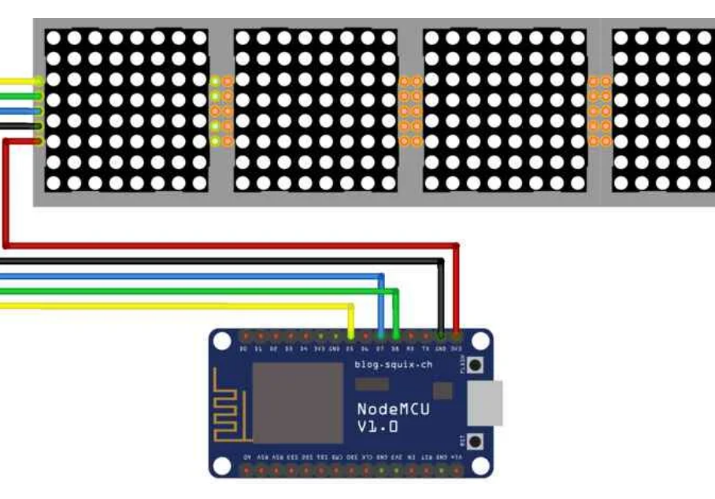
CIRCUIT DIAGRAM:
Procedure:-
1. Connect all components as per the circuit diagram.
2. Write and upload the code to the microcontroller using Arduino IDE.
3. Power the circuit using a 9V battery or adapter.
4. Use the web/mobile interface to send messages to the display.
5. Verify that the messages are displayed in real-time on the screen.

Slide 9
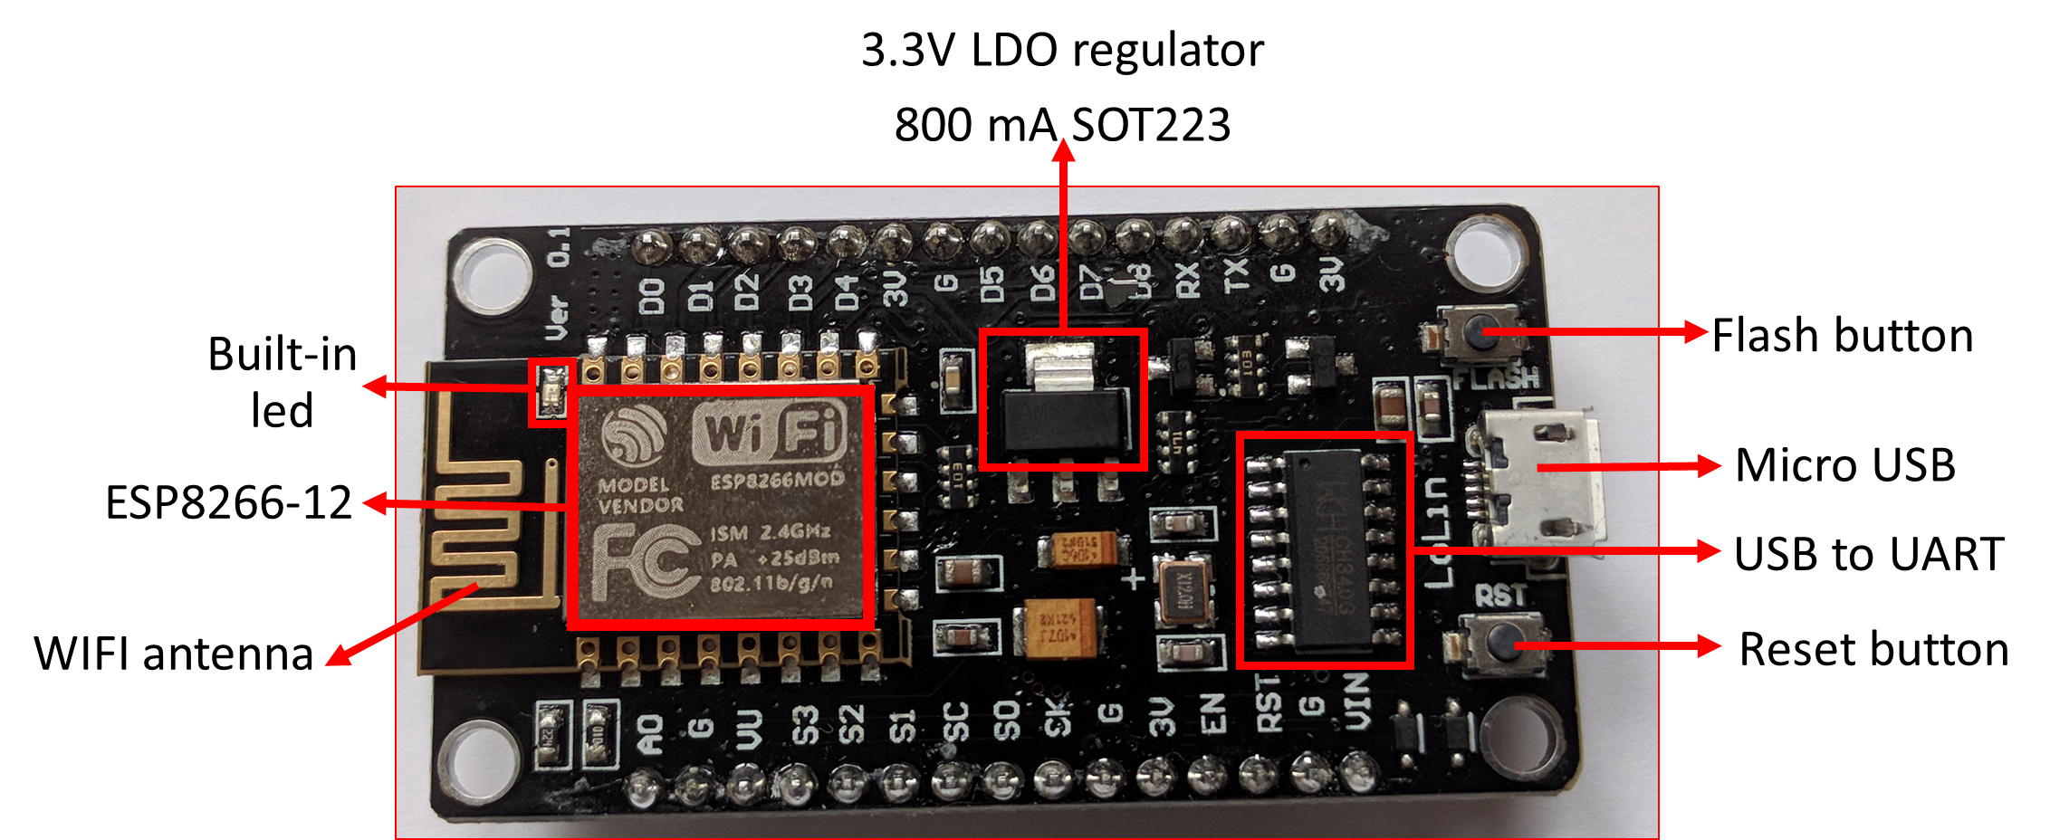
Micro-controller (ESP8266)
ESP8266 control the display and process data.
The ESP8266 serves as the brain of the system.
It processes data, receives updates via Wi-Fi, and controls the display screen.
ESP8266 has Wi-Fi capabilities but fewer GPIO pins.
ESP32 is more powerful, with dual-core processing, more GPIO pins, and both Wi-Fi & Bluetooth support.
It runs the blynk that fetches messages from a server or app and displays them.

Slide 10
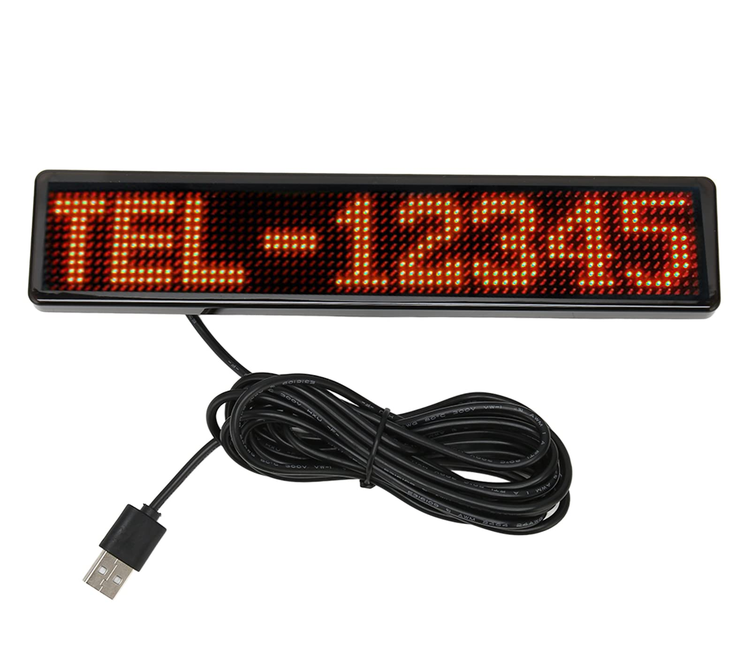
Display Screen
The Screen is used to show real-time messages, notices, and announcements.
The 8×8 LED matrix is connected to the MAX7219, receiving data input from the Arduino board.
TLED Matrix (MAX7219): Used for bright outdoor or indoor scrolling displays.
MAX7219 is a common cathode display driver with serial input and parallel output, used to interface 64 individual LEDs with microprocessors or microcontrollers.

Slide 11
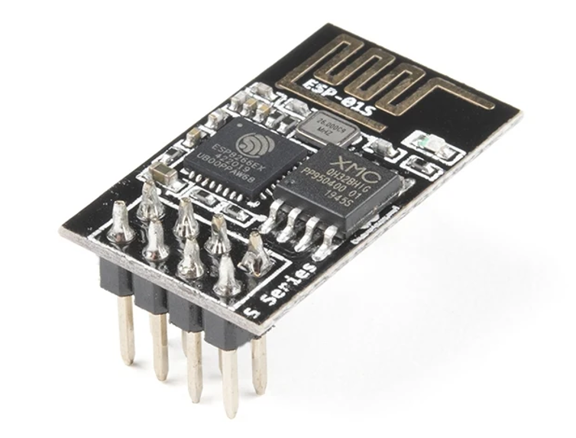
Wireless Connection module
Allows the display board to update messages remotely via a smartphone or server.
Wi-Fi (ESP8266): Connects to the internet and retrieves messages from a cloud server or local system.
The system can receive real-time updates from Blynk, MQTT, HTTP server, or a custom app.

Slide 12
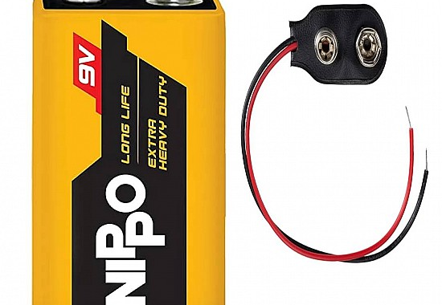
Power supply
A 9V Battery:
The nine-volt battery, 9V Battery, is an electric battery
that supplies a nominal voltage of 9 volts. Actual voltage
measures 7.2 to 9.6 volts. Here we 9V battery for power
supply to execute the working process.

Slide 13
Advantages
1. Eco-Friendly:- Eliminates paper usage, reducing waste and promoting sustainability.
2. Real-Time Updates:- Notices can be updated instantly from anywhere.
3. User-Friendly:- Easy-to-use web/mobile interface for administrators.
4. Versatile:- Can be used in schools, offices, and public spaces.

Slide 14


